Slide 1
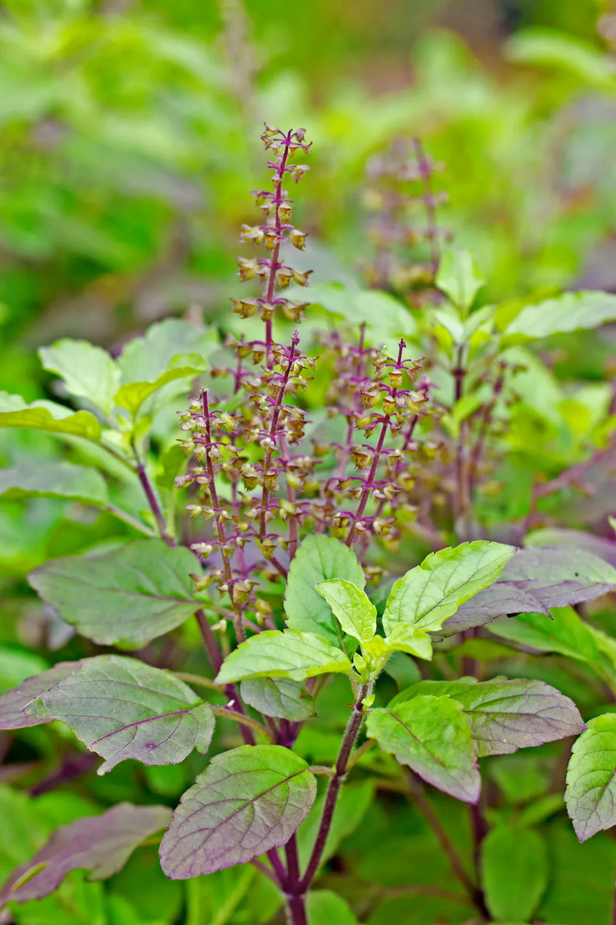
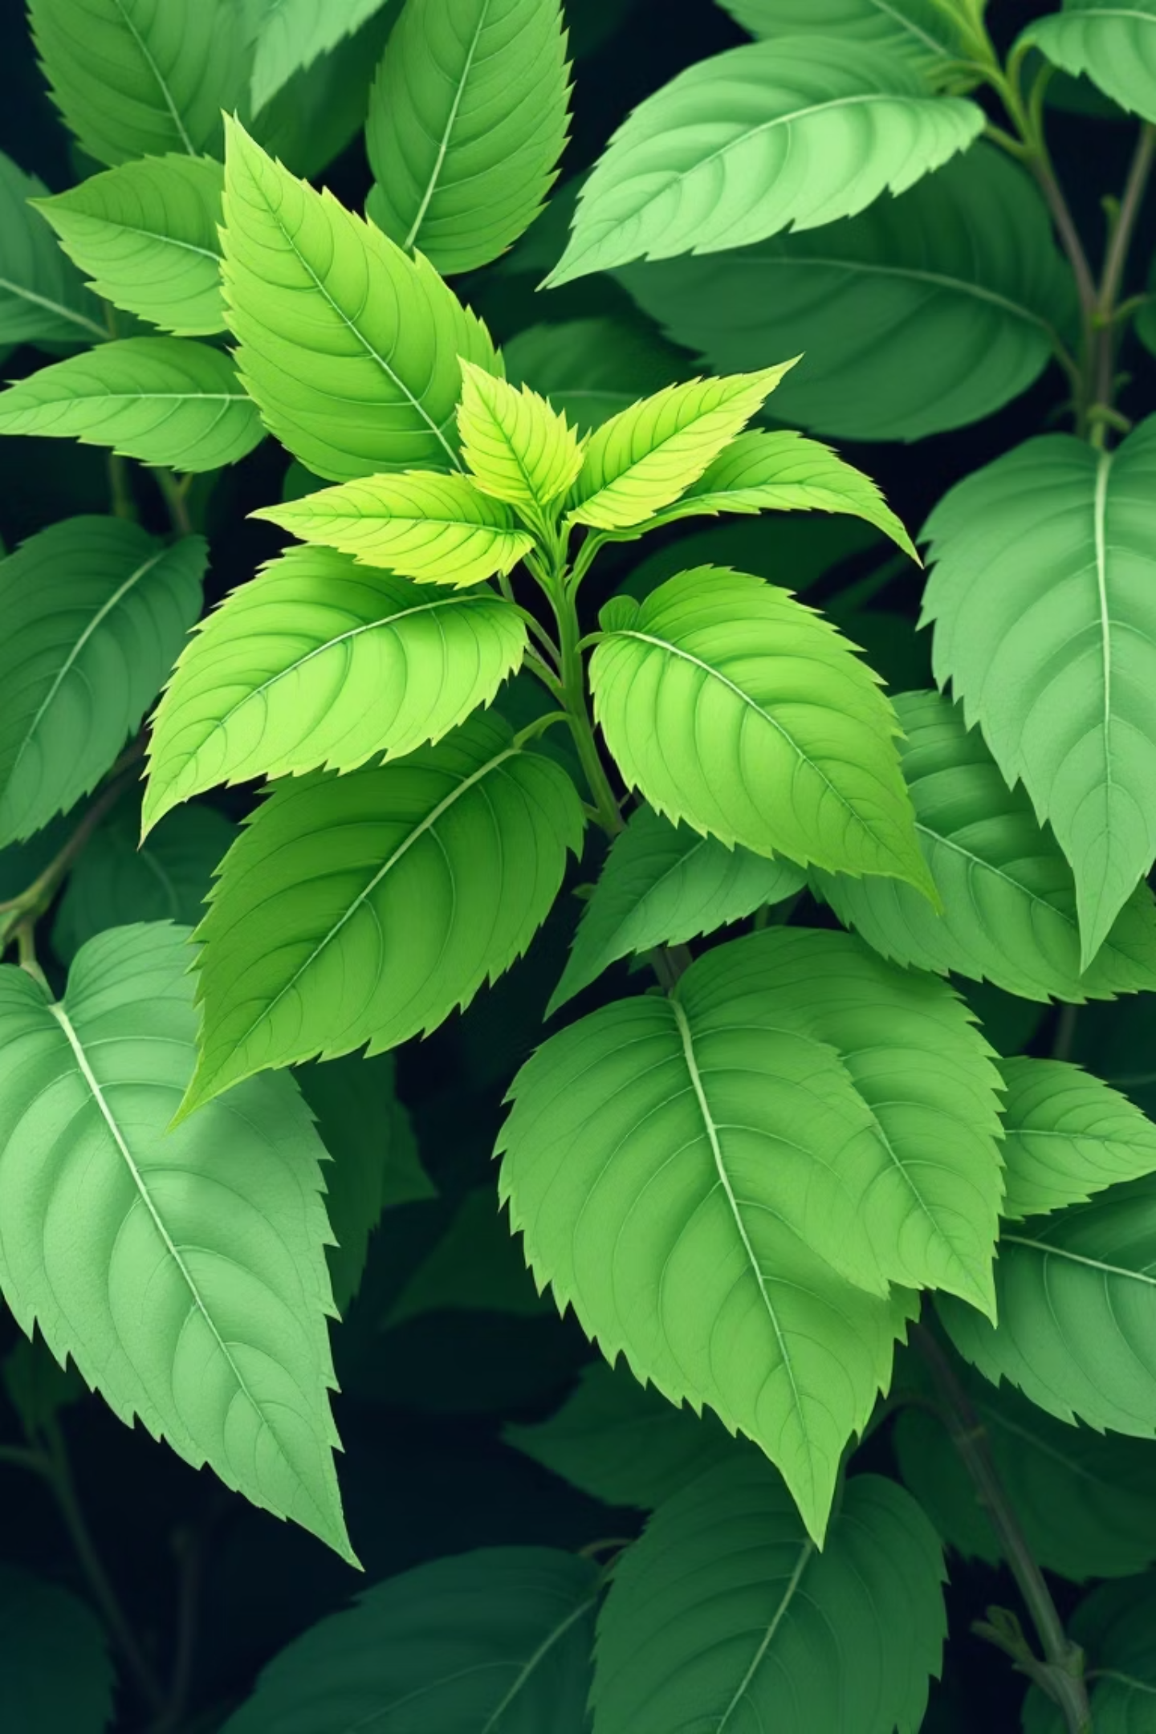
Automated Tulsi Leaf Disease Detection
Presented By: -
Diya Arvadia (23BEC094)
Shweta Sharma (23BEC095)
Ayush Kumar Singh (23BEC097)
Yug KetanKumar Dhamsania (23BEC098)
Yash Dasadia (23BEC106)

Slide 2
Project Introduction
Early and accurate identification of diseases in Tulsi (Holy Basil) is critical. This project developed a machine learning system for automated detection of Tulsi leaf diseases using a Convolutional Neural Network (CNN) with Transfer Learning.
Importance of Tulsi
Tulsi (Ocimum tenuiflorum), or Holy Basil, is a vital medicinal plant in Indian tradition and Ayurveda, revered for its spiritual and healing properties. It reduces inflammation, fights infections, and protects against stress.
Globally, Tulsi is a key ingredient in herbal supplements, making its quality and cultivation essential.
Model
Classes
Accuracy
MobileNetV2 fine-tuned on 2,274 images.
Healthy, Bacterial, Fungal, Pest-affected.
Achieved a remarkable 91.6% on validation.

Slide 3
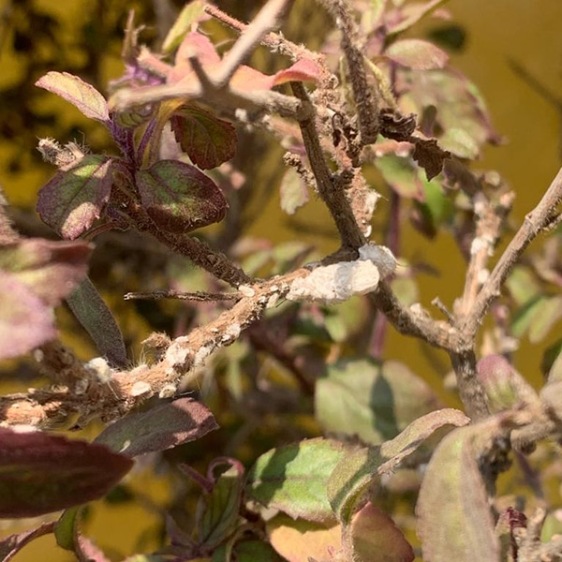
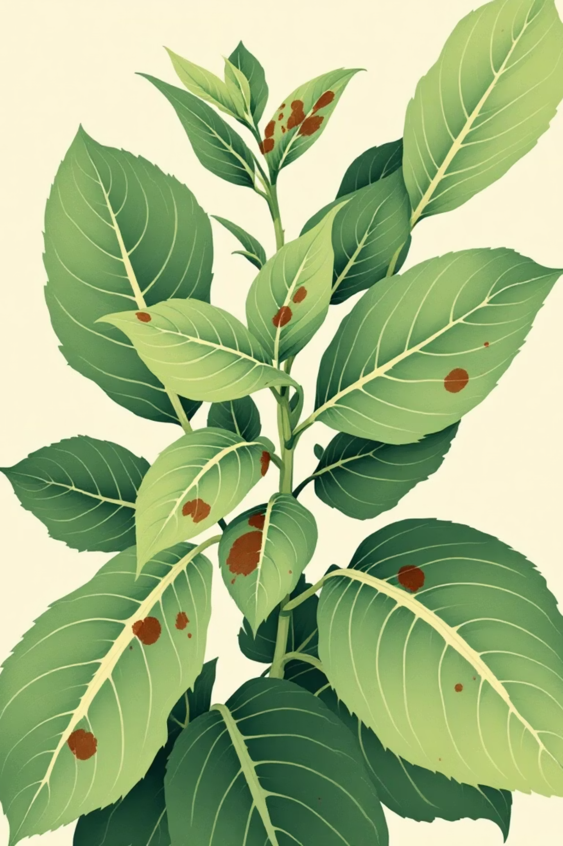



Problem: The Threat of Plant Diseases
Bacterial & Fungal
Visible Symptoms
Tulsi is susceptible to diseases from bacteria, fungi, and pests.
Diseases manifest as spots, yellowing, drying, or wilting leaves.
Impact
These reduce growth, affect photosynthesis, and lower medicinal quality.
Untimely detection leads to rapid spread and significant harvest damage.

Slide 4








Objective & Classification
Our main goal is to build and evaluate a Transfer learning model for classifying Tulsi leaf images into four categories.
Healthy
Bacterial
No visible signs of disease or damage.
Infections caused by bacterial pathogens.
Pest-affected
Fungal
Damage caused by insects or other pests.
Diseases resulting from fungal growth.
This system aims to support early detection, reduce crop damage, and promote sustainable farming.

Slide 5
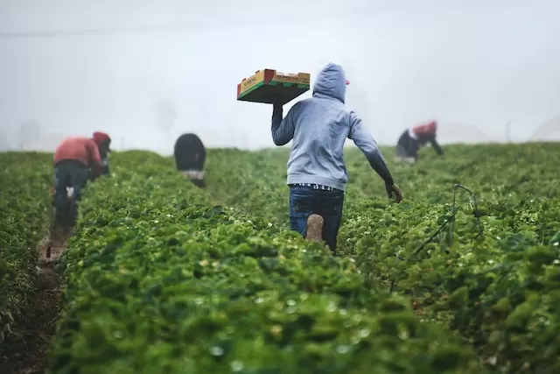


Challenges in Conventional Methods
Subjective & Inaccurate
Visual inspection by farmers is prone to human error and bias.
Slow & Labor-Intensive
Manually checking each plant is time-consuming and inefficient.
Not Scalable
Unsuitable for large farms, hindering efficient cultivation.
These limitations highlight the urgent need for an accurate, automated detection system.

Slide 6




Proposed Solution: Transfer Learning
Leveraging AI, this project uses Transfer Learning with MobileNetV2 for automated disease detection.
Limited Datasets
Works effectively even with smaller datasets.
Faster Training
Significantly reduces training time.
High Accuracy
Benefits from prior learning on ImageNet.
Lightweight Model
Ideal for real-world, on-device applications.

Slide 7
Dataset & Augmentation
Dataset Specifications
Data Preprocessing
Source: Kaggle Tulsi Leaf Dataset by Manjot Kaur HPK
Image Resizing: 224x224 pixels
Total Images: 2,274 (natural outdoor conditions)
Pixel Normalization: Scaled to [0, 1]
Classes: 4 (Healthy, Bacterial, Fungal, Pests)
Color Channels: Maintained RGB
Split: 80% Training (1,820), 20% Validation (454)
Data Augmentation Strategy
To prevent overfitting with limited data, comprehensive augmentation was applied:
Rotation: ±30 degrees
Zoom: 20% random
Shifting: 10% horizontal/vertical
Shearing: 10%
Flipping: Horizontal

Slide 8
Model Architecture & Training
Model Configuration
Two-Phase Training Strategy
Base Model: MobileNetV2 (ImageNet pre-trained)
01
Input Shape: 224x224x3
Phase 1: Base Training (20 Epochs)
Custom Layers: GlobalAveragePooling2D, Dropout (0.3), Dense (4 units, softmax)
Frozen MobileNetV2 layers; only custom layers trainable.
02
Optimizer: Adam
Phase 2: Fine-tuning (10 Epochs)
Loss Function: Categorical Crossentropy
Top 100 MobileNetV2 layers unfrozen; reduced learning rate.

Slide 9
Detailed Performance Analysis
The model demonstrated exceptional performance, particularly in detecting pest-affected and bacterial leaves.
Bacterial
1.00
0.82
0.90
40
Fungal
0.95
0.36
0.52
98
Healthy
0.69
1.00
0.82
153
Pests
1.00
1.00
1.00
163
Key Observation: Fungal class shows high precision (95%) but low recall (36%), with 63/98 fungal samples misclassified as healthy. This suggests visual similarity between early fungal symptoms and healthy leaves.

Slide 10
Training Strategy & Evaluation
Our training involved a two-phase approach for optimal learning and performance.
Phase 1: Base Training
1
20 Epochs. MobileNetV2 layers frozen. Only custom classification layers trained (5,124 parameters). Purpose: Learn to interpret MobileNetV2 features.
2
Phase 2: Fine-tuning
10 Epochs. Top 100 layers of MobileNetV2 unfrozen. Learning rate reduced to 1e-5. Purpose: Refine feature extraction for Tulsi-specific patterns.
Key Performance Metrics
91.63%
0.2522
94.70%
0.2165
Validation Accuracy
Validation Loss
Training Accuracy
Training Loss
The minimal gap between training and validation accuracy (approx. 3%) indicates effective regularization and minimal overfitting.

Slide 11
Conclusion & Future Directions
This project successfully developed an automated system for Tulsi leaf disease detection, achieving 91.6% validation accuracy.
Significant Improvement
1
16.6% improvement over previous research, validating transfer learning for limited datasets.
Practical Applications
2
Early warning for farmers, quality control in herbal medicine, and sustainable agriculture.
Future Work
3
Mobile app development, dataset expansion, advanced visualization, and multi-plant support.

Slide 12
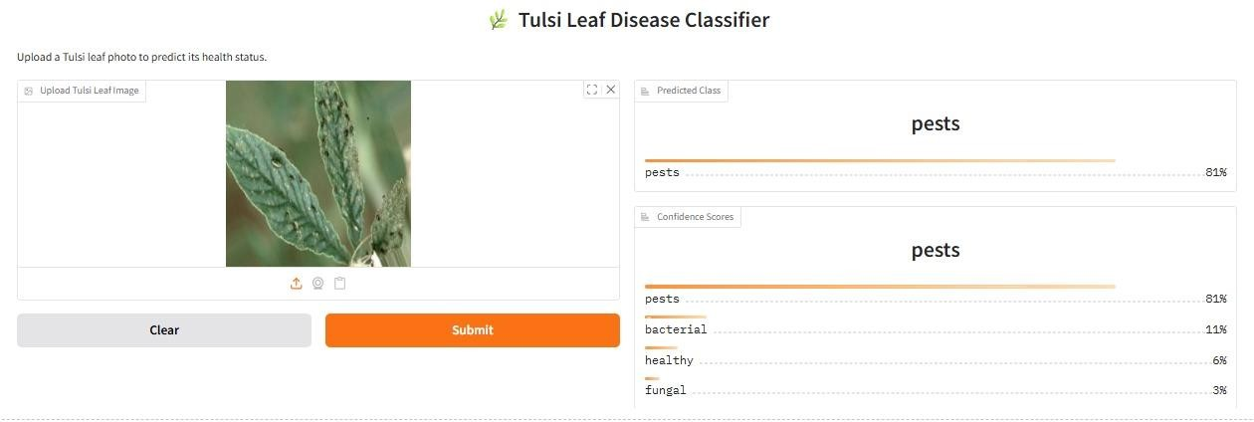
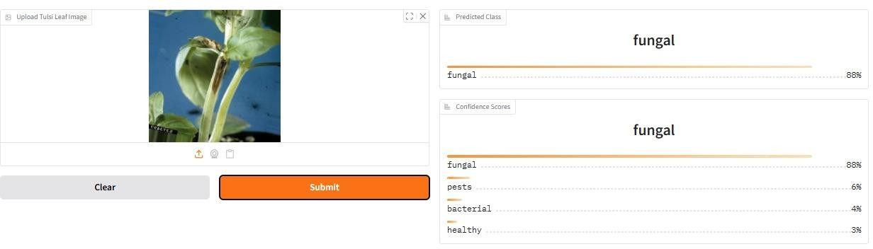
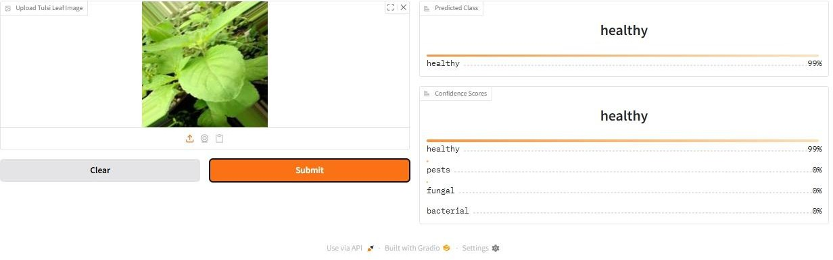
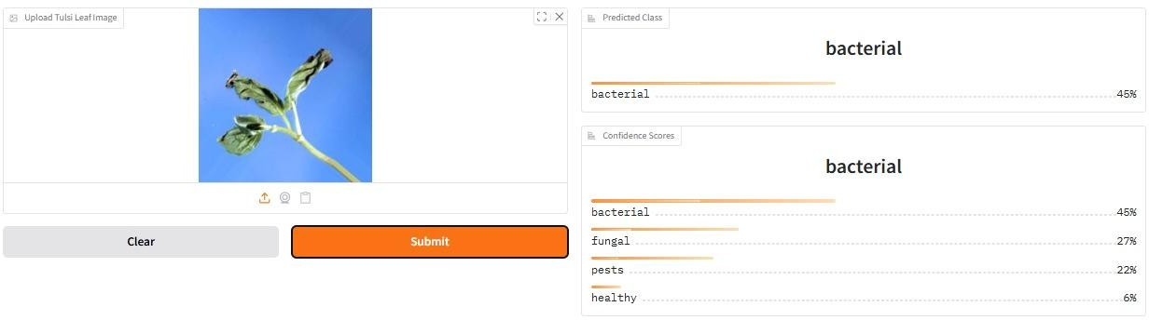
Results: -

Slide 13
Thank You

